Slide 1
EMIA 2020 Group 5 Presentation
Engineering PG TA and their challenges

Slide 2
Rationale
01
Target groups
02
Table of contents
observation
03
Interview
04
Reasoning for the focus area
Affected users and stakeholders
Direct findings in the field
First-hand accounts of users/stakeholders

Slide 3
Personas
05
analysis
06
Table of contents
Define problems
07
appendix
08
Summarised profiles of users/stakeholders
Breakdown of findings; the WHY’s
The three potential challenges
Additional information

Slide 4
Team members
CHAN, Chun Hin
CHAN, Shing Chung
CHAU, Chun Kai
HWANG, Jaehee
SIDAURUK, Farrell Nathaniel Azvari

Slide 5
01
rationale
Reasoning for the
focus area

Slide 6
Original focus areas
Sidauruk, farrell nathaniel azvari
01
CHAN, Chun Hin (Vincent)
05
02
CHAN, Shing Chung (SAMMul)
HWANG, Jaehee
04
03
CHAU, Chun Kai (Jaga)
Quality of Study for First-
Year UG Students
Quality of Education in SENG
Challenges for University TA
AI Tools in University Study
Motivation of UG Students

Slide 7
Why this focus area?
4
2
1
3
5
Engineering TA’s and Their Potential Struggles
University settings are our common interests
Narrowing down to Engineering faculty for more specific analysis
Sharing research among team members
Limited existing research on TA, we decided TA is an unique angle
Concluded that Engineering TA in HKUST is our focus area, while keeping others as stakeholders

Slide 8
02
Target groups
Affected users and stakeholders

Slide 9
Users
postgraduate engineering teaching assistants in HKUST
(PG TA)
Main teaching assistants in charge of tutorials and labs

Slide 10
stakeholders
Undergraduate students in HKUST
Undergraduate engineering teaching assistants in HKUST
Professors in HKUST
Direct supervisors of PG TA who oversee their research and other duties
Main audience in tutorial/lab sessions held by PG TA
Junior colleagues assisting PG TA’s teaching work

Slide 11
03
observation
Direct findings in the field

Slide 12
KEY Assumption
The BIGGEST challenge faced by PG TA is their teaching in
tutorial and lab sessions.

Slide 13
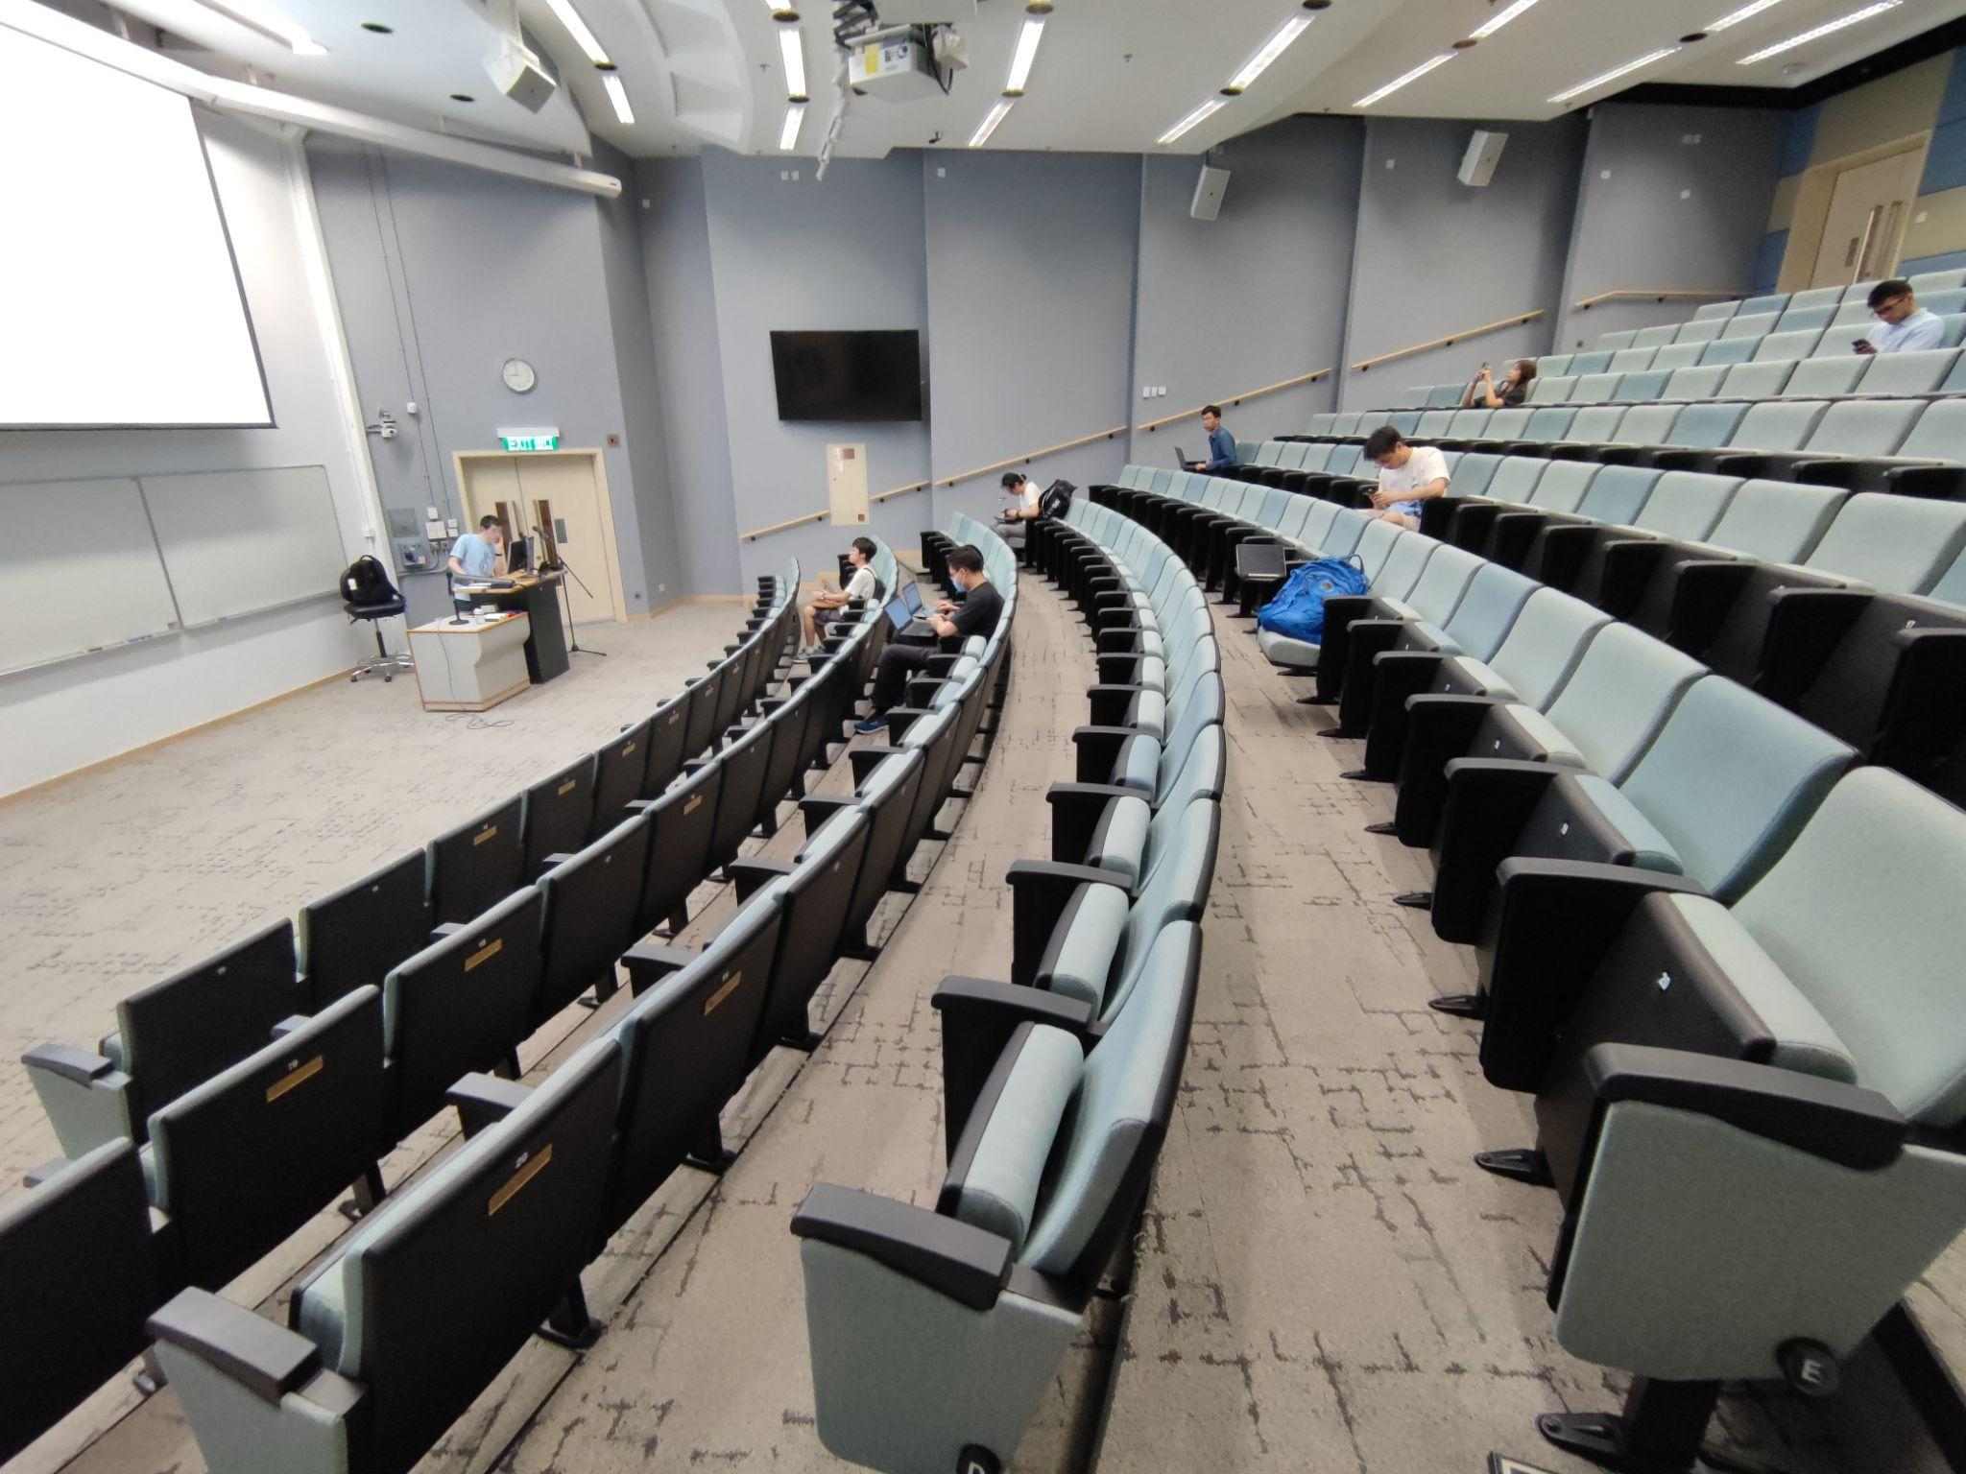
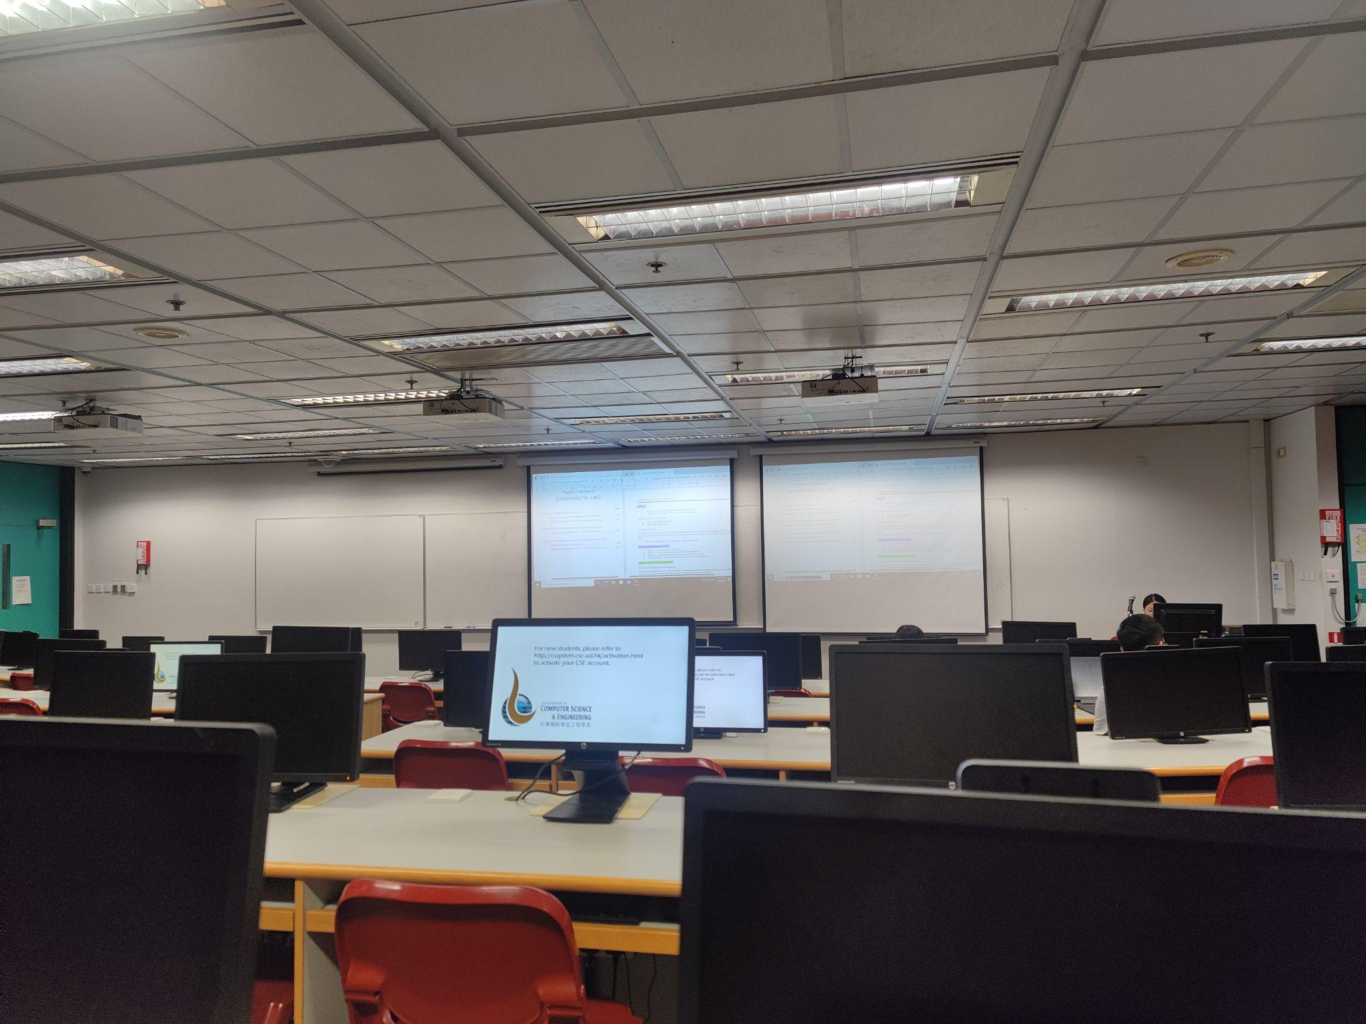
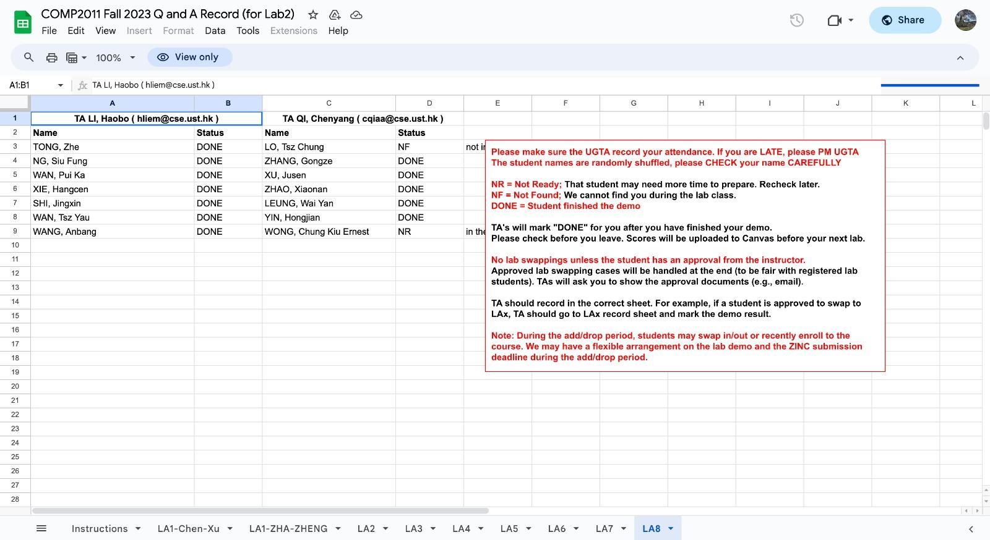
FIELD STUDY
Figure 1: Photo of COMP 3511 lab
Figure 2: Photo of COMP 3111H lab
Figure 3: Photo of COMP 2011 lab

Slide 14
COMP 3511 lab
Shot on 22 September, 2023
From 9am to 11am
About C programming on Linux shell
78 students enrolls in this session
Around 10 students attend
TA’s name:Ye, Peng
During the beginning of the lab:
The teaching tone: boring
Most students feel sleepy
Only the student wearing blue jacket is listening to what the TA has said
TA’s challenge:
Difficulty in making the lab more interesting

Slide 15
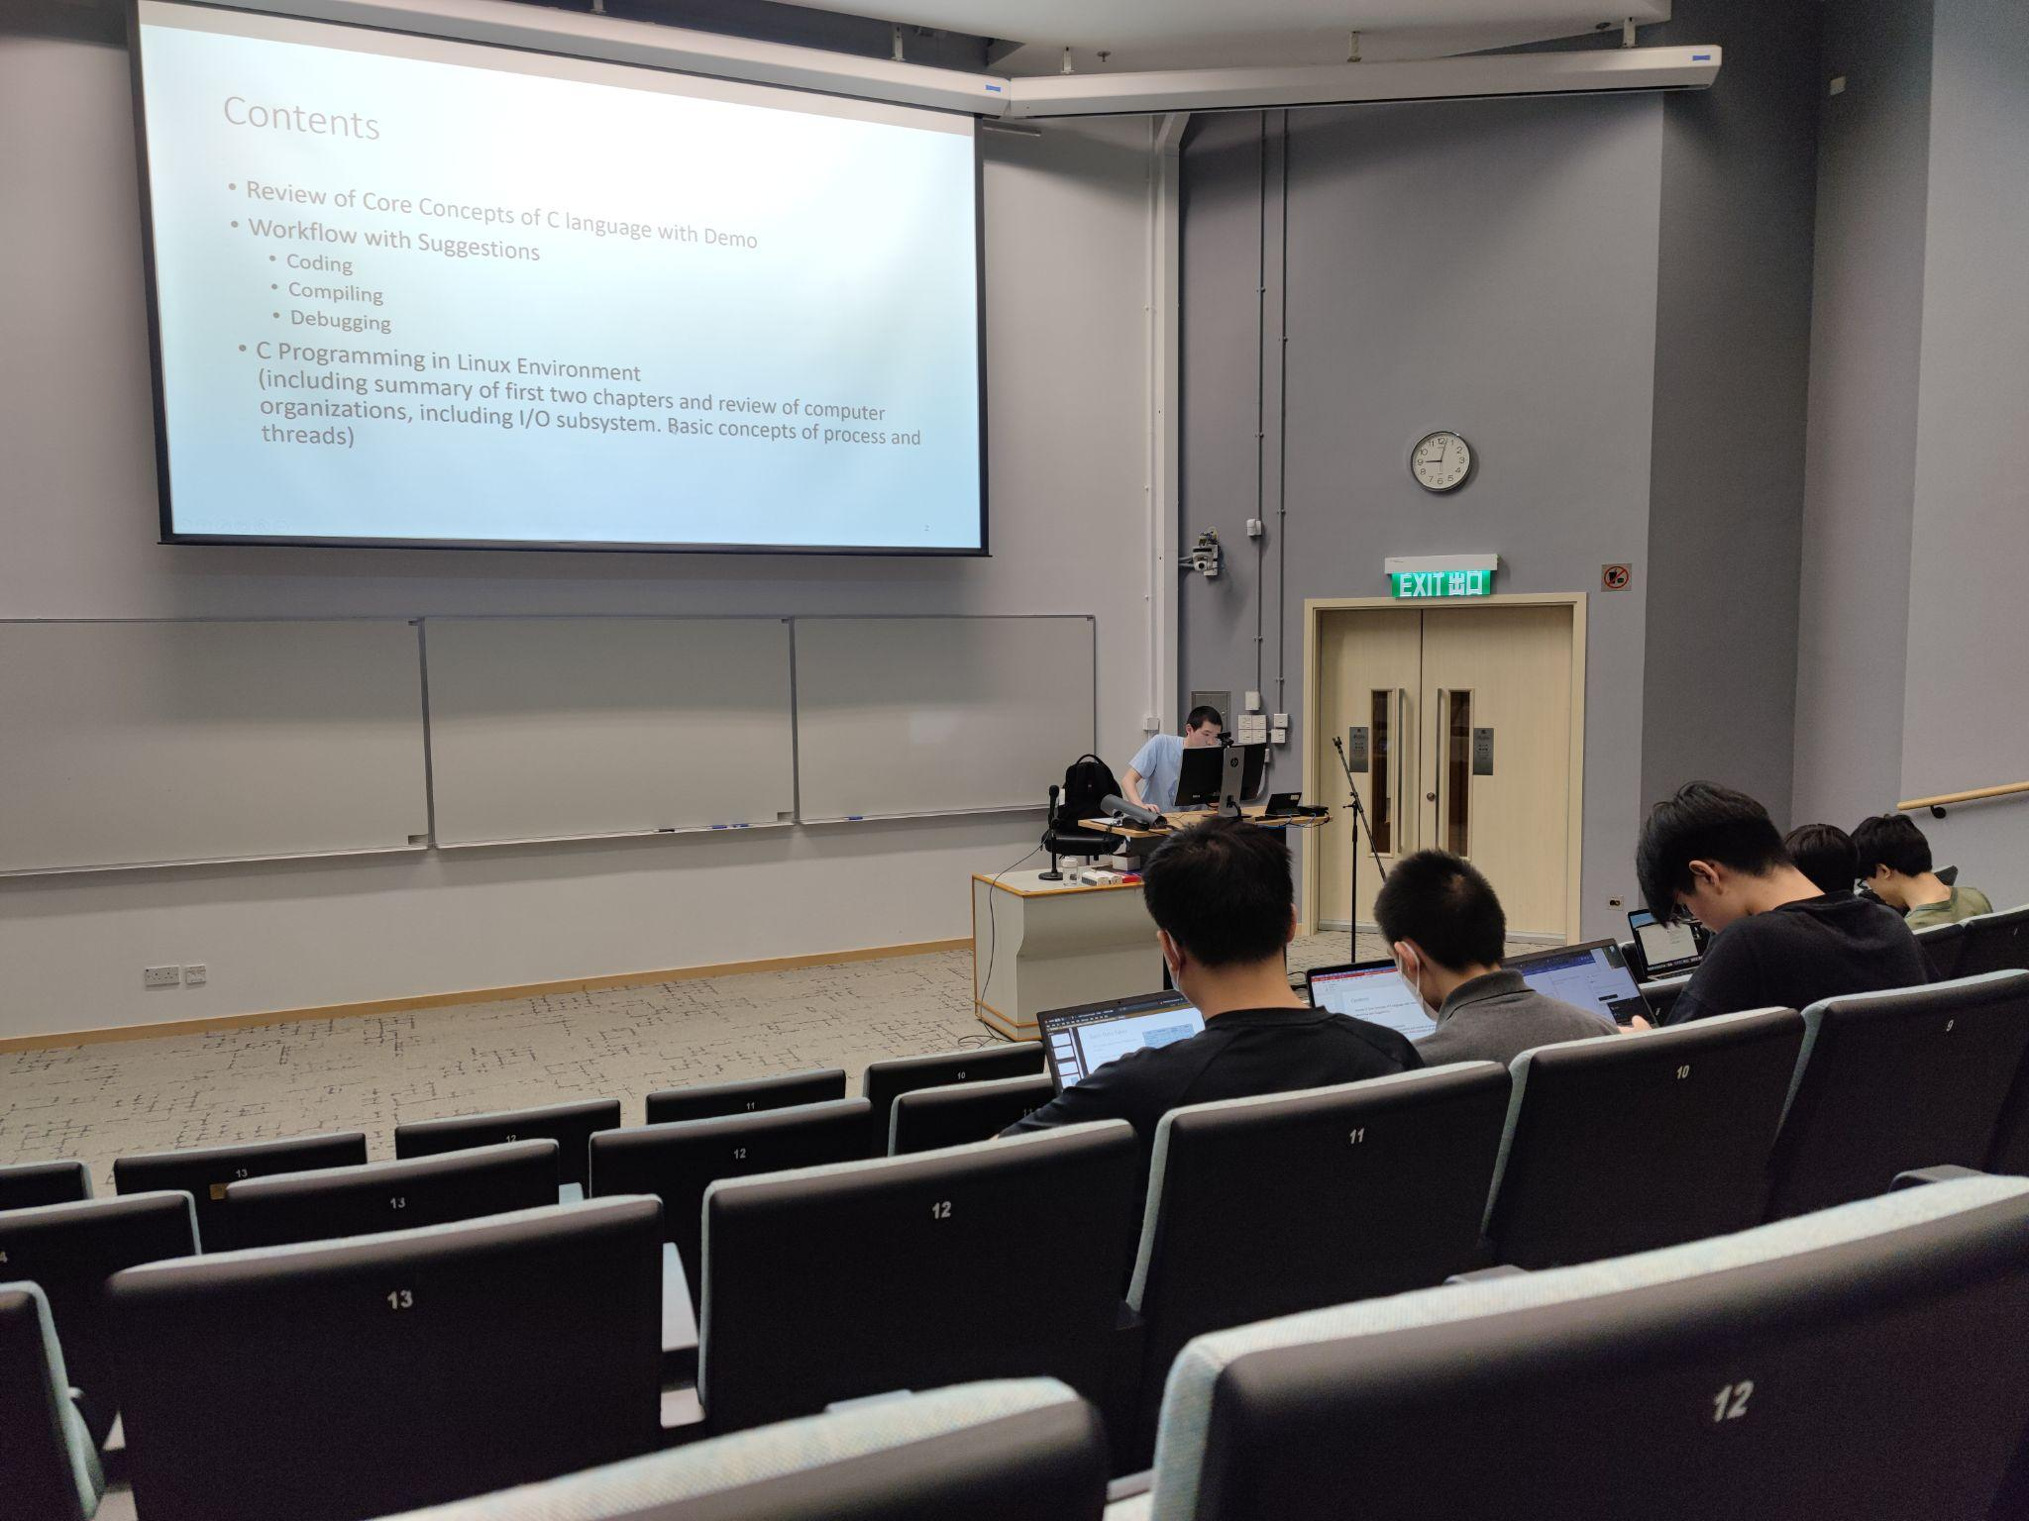
During the middle of the lab:
Students on the front row starts to do the assignments from other courses
TA rarely ask questions to students
Nobody answers TA’s questions
Nobody ask questions during the lab
One student said he would skip the labs starting next week
TA’s Challenges:
Hard to bring interactive elements to the lab
Unable to know whether the undergraduate students know the concepts or not

Slide 16
COMP 3111H lab
Shot on 22 September, 2023, 1:00 pm- 3:00 pm
About Java programming basic
24 students enrolled in this session
Less than 5 students attended
TA’s name: Hu, Yuer
The teaching tone: monotonous
The TA was unwilling to teach
After 15 minutes of teaching, she just sit there to see if anyone has questions afterwards
Only 1 student approached her to ask the lab materials
TA’s challenge:
Some TAs has lost the passion in teaching due to the low participation rate

Slide 17
COMP 2011 Lab
29 September 2023, 11a.m. - 1p.m.
Online Zoom meeting
1 UG-TA, and 2 PG-TAs with their breakout rooms, where students take turn joining them to discuss about their labs.
Finding: Not much communication between TAs at all - only through Google Spreadsheet
Problem: One PG-TA might be slower than the other when discussing with students - one still tutoring but the other is finished, the students with slower TA will have to wait without any clear updates
Not much going on in the labs

Slide 18
FIELD STUDY FINDINGS
Common Features
Low student engagement rate
Less than 20% of enrolled students have attended
Little to no student response from TA’s questions
Students on side doing irrelevant things (other class, games, videos)
Low teaching motivation
TA reading off slides in monotonous tone
Cannot receive feedback after repeated asking
One TA just kept idle after 15 minutes

Slide 19
KEY Assumption?
Teaching is observed to be a challenge.
Is it the BIGGEST one?

Slide 20
04
interview
First-hand accounts of users/stakeholders

Slide 21
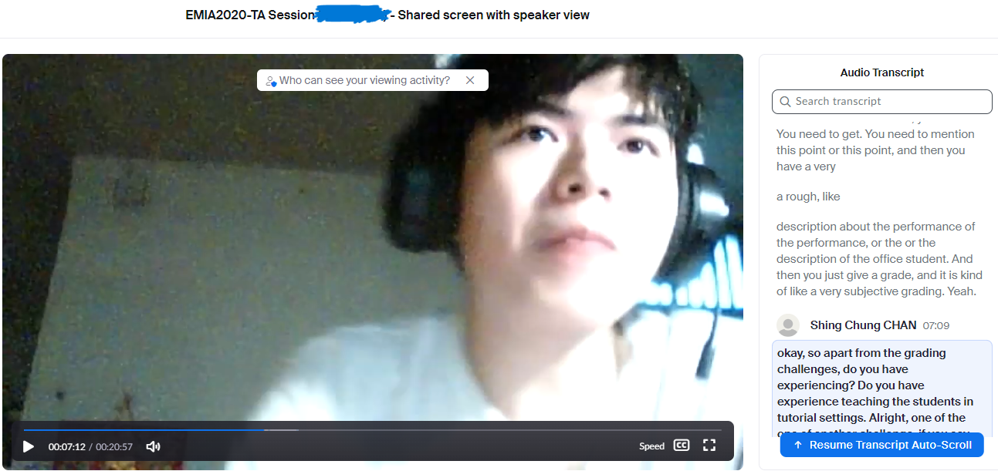
Interview with PG TA - Round 1
TA from EMIA 2020
Interviewed via Zoom
More inclined towards an extreme user (more passionate and committed)

Slide 22
Interview with PG TA - Round 1
Highlight Moments
Not all PG TA are committed to teaching UG students since they’re not motivated.
Some PG TA prioritize research over TA work so they might “rush through their work”.
While there is low student attendance, remaining students are attentive.
Unexpected Findings
TA are actually also PG, so their research took time. (Verified assumption: multiple workload)
Some TA didn’t feel the pressure to overperform in teaching, but prefer to save time. (Rejected assumption: PG TAs are motivated to teaching in general)
Grading was only an issue in specific Engineering courses, but not with model answers. (Generated assumption: grading could be a prevalent challenge)
PG TA have other challenges such as PG research and administrative work.

Slide 23
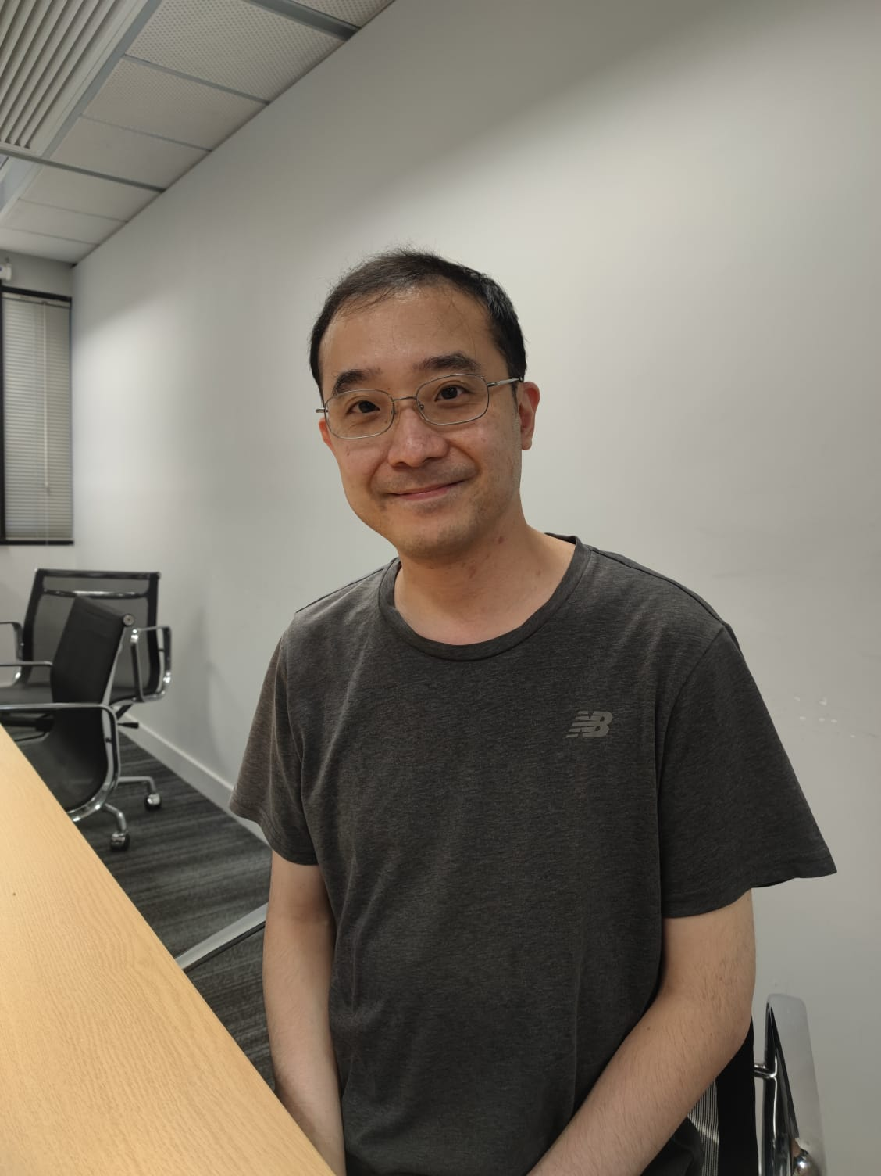
Interview with Professor Desmond - Round 2
Computer Science and Engineering Professor
Interviewed in person
Very interactive in lectures (and interviews)

Slide 24
Interview with Professor Desmond - Round 2
Highlight Moments
Giving practical examples is a good way to teach.
Suggests that time management is a key skill for PG TAs.
PG TAs may find a hard time fulfilling their professors’ requirements.
Some professors find the passion of PG TA more important than their knowledge.
Unexpected Findings
Deadlines of TA work and PG work could clash. (Generated assumption: PG TA may have hard time with time management)
TAs can meet with supervisors 4 hours per meeting, more than once a week. (Verified assumption: PG TA have multiple workload)
Selecting appropriate research topic is much harder than 10 years ago. (Verified assumption: Research is a major challenge for PG TA)
Research work and meeting with Professors are a big challenge for PG TA to manage time as well.

Slide 25
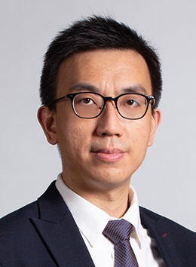
Interview with Professor Rong - Round 2
Emerging Disciplinary Areas Professor
Interviewed in person
Also very interactive in lectures (and interviews)

Slide 26
Interview with Professor Rong - Round 2
Unexpected Findings
Meeting times could be shorter with clear structure and person-in-charge. (Generated assumption: meeting times could be shorter with high efficiency)
PG TAs also receive anonymous survey for feedback. (Generated assumption: Anonymous survey help with communication)
Some PG TAs have the flexibility to split the work among each other. (Generated assumption: there is sufficient communication among PG TA)
Highlight Moments
Back as PG TA, research duty was heavier than TA duty.
Treated TA duty as commitment, so no problem accepting the workload
Emphasized the importance of time. management and self-motivation for PG students.
Have a dedicated TA to help with communication among PG TA.
Time management is a recurring theme for PG TA from Professor perspective.

Slide 27
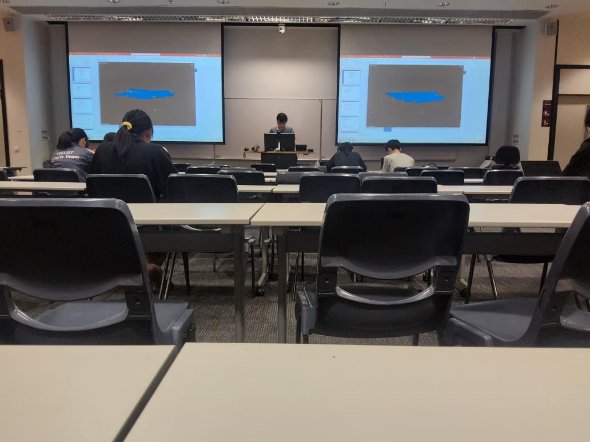
Interview with PG TA (1) - Round 2
PG TA in Civil Engineering
Interviewed in person after tutorial session
More inclined towards a majority user

Slide 28
Interview with PG TA (1) - Round 2
Unexpected Findings
Most PG TA had problems managing multiple workloads, leading to lack of sleep. (Verified assumption: Most PG TA have hard time with time management)
Very long meeting time with supervisors, but not much communication with Professors. (Generated assumption: there is a communication challenge between PG and Professors)
Some PG TAs have to attend every lecture the Professor teaches. (Verified assumption: multiple workload for PG TA)
Highlight Moments
PG TAs find balancing out research and teaching quite difficult.
Long commuting time for PG TAs not living in campus made time management even more challenging.
Committed to communicate with students, but do not understand why students had difficulties with content.
Regular meetings and other administrative work made time management very challenging for PG TA.

Slide 29
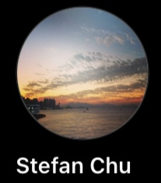
Interview with PG TA (2) - Round 2
Another Civil Engineering PG TA (coincidentally)
Interviewed in person
Suffers from heavy workload of research

Slide 30
Interview with PG TA (2) - Round 2
Unexpected Findings
For some tutorials, the professor attends every tutorial to oversee. (Verified assumption: there can be ways to shorten meetings)
PG research highly depends on professors, such as meeting time and workload. (Verified assumption: Research is a major challenge for PG TA)
Used groupchat with other TAs to discuss about courses instead of regular meetings. (Verified assumption: there is sufficient and efficient communication between TA)
Highlight Moments
Students are not voluntary to interact with TAs during the class, which leads to low student engagement.
However, they come with stream of questions after class via emails.
Research is main priority for PG TA.
Teaching itself is straightforward and not challenging.
Answering questions to students is the most time-consuming task.
Heavy workload of PG research and TA work leads to lack of sleep.
Research work and answering questions after class might be more time-consuming than teaching.

Slide 31
Interview with UG TA - Round 2
Undergraduate TA in COMP 2011
Interviewed through Zoom
Genuinely enjoys teaching

Slide 32
Interview with UG TA - Round 2
Unexpected Findings
Almost no communication between UG TA and the PG TA or the professor. (Verified assumption: Communication between TA and Professor is a challenge)
The UG TA genuinely enjoys teaching, even in a smaller capacity. (Generated assumption: UG TA might be a more suitable candidate for teaching)
The UG TA did not know that there was any UG TA back when he was doing the course himself. (Generated assumption: Number of UG TA is on the rise.)
Highlight Moments
The UG TA was a bit confused at first, so he was going to plan further ahead of what he was going to do.
Most UG-TA are self-taught for the classes, potentially showing why some students might not be engaged.
UGTA are generally enthusiastic throughout the interview. Despite the challenges, he still enjoyed his role.
UG TA are enthusiastic assistants, but currently they lack clear structures to provide effective help.

Slide 33
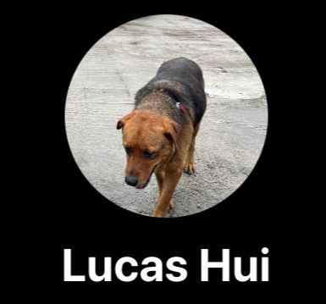
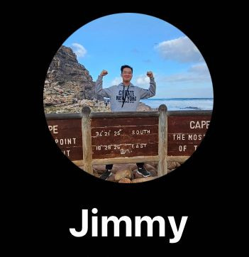
Interview with UG students - Round 2
2 Undergraduate Engineering Students
Interviewed in person
One is extreme stakeholder while the other is majority stakeholder

Slide 34
Interview with UG students - Round 2
Highlight Moments
Students generally think that attending tutorials is a waste of time
They preferred TAs with teaching skills and disliked TAs without engagement and experience
They desired the need of out-of-class support such as WhatsApp
They believe training for TAs can improve their teaching
Unexpected Findings
Engineering UG students thought tutorials were waste of time, but valued asking questions after class. (Verified assumption: UG students preferred asking outside class)
They preferred supportive learning materials over mandatory presence in class. (Generated assumption: PG TA’s time might be better spent outside tutorial)
UG students value the opportunity to ask questions, but not the in-class time with TAs

Slide 35
Revisit assumption
Teaching is a challenge for some PG TA,
but time management is a more significant and prevalent challenge.

Slide 36
05
PERSONA

Slide 37
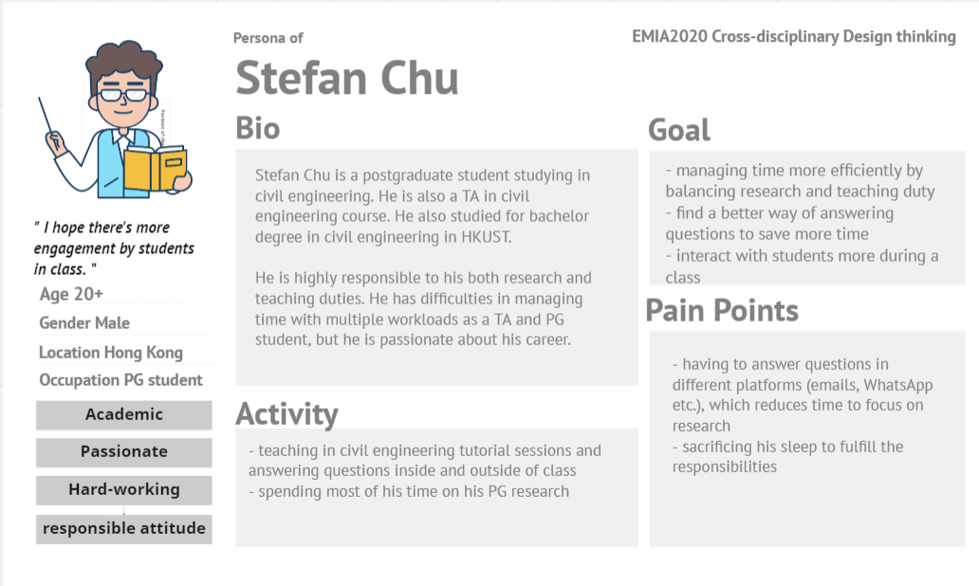

Slide 38
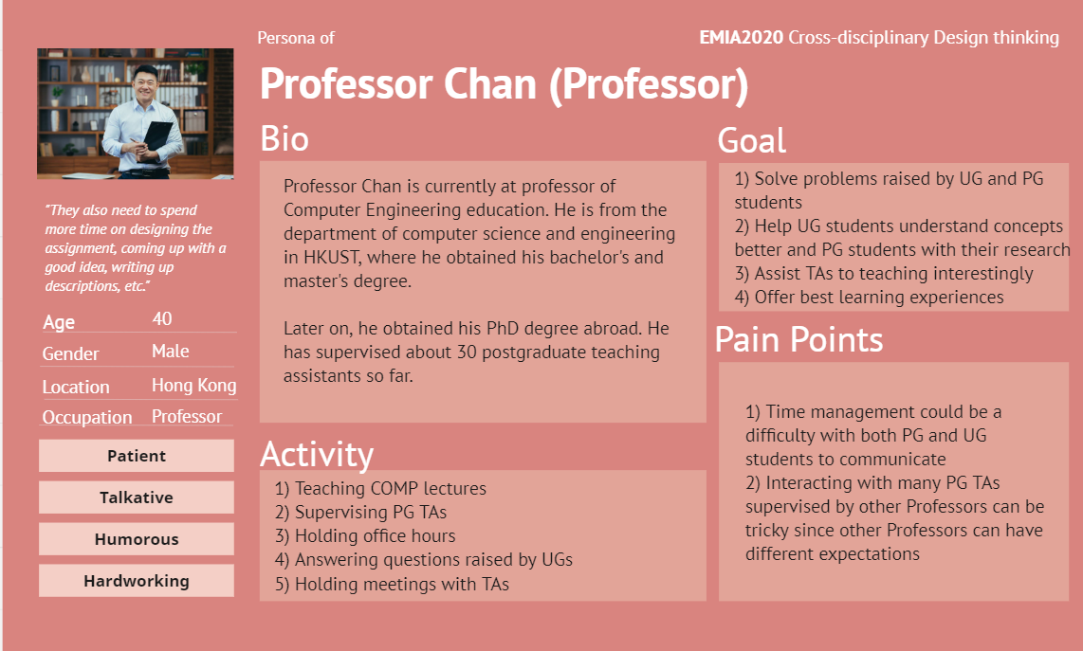

Slide 39
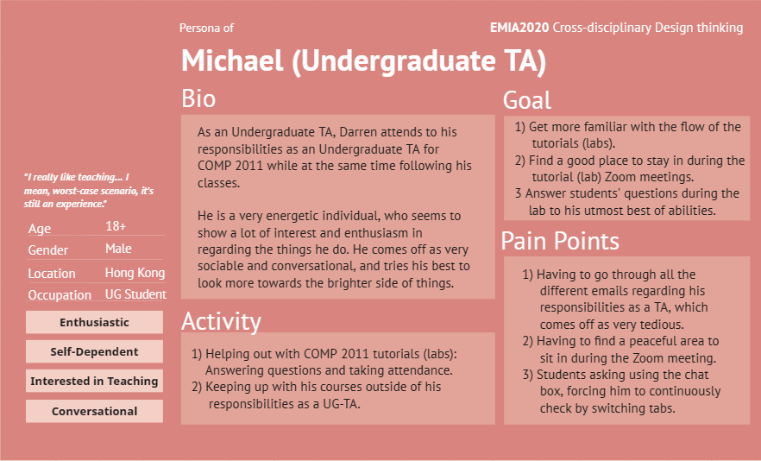


Slide 40
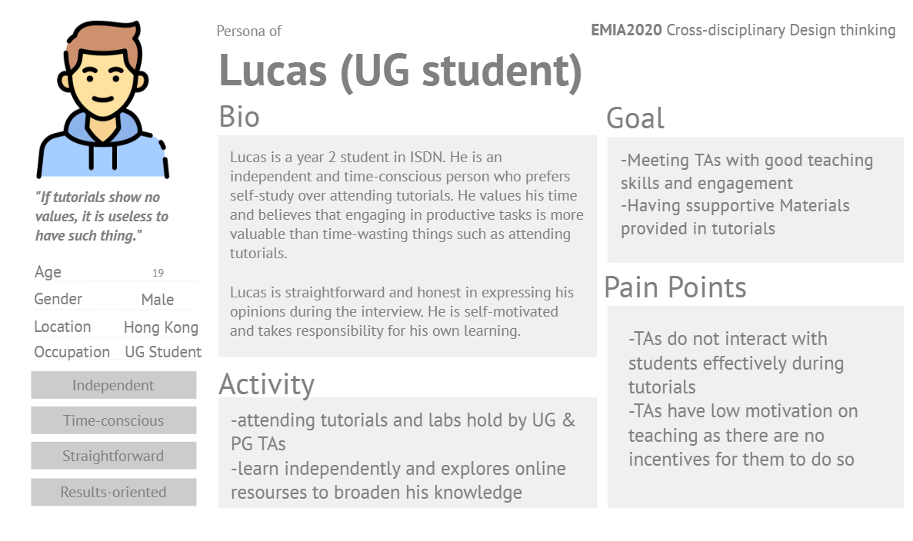

Slide 41
06
ANALYSIS

Slide 42
What are the main tasks of TAs?
List of main tasks:
have to prepare undergraduate course assignments
Prepare undergraduate course labs/tutorials materials
Do grading (assignments, midterm exam, final exam)
Write research thesis
Conduct office hours to answer questions to students
Have frequent meetings with supervisors
Do rehearsal before the labs/tutorials begin
Lack of sleep due to heavy workload
Main challenges that we identify:
They lack sleep due to large amount of workload
Convenient ways of answering questions for students (in and out of office hours, through emails and WhatsApp)
Have frequent meetings with supervisors

Slide 43
Why they want more sleep time?
Current Situation:
PG TAs have a lot of responsibilities, such as meetings and tutorials, which take a lot of their time away from their own postgraduate research.
PG TAs have to spend a lot of time for commute in-between their responsibilities which reduces the time for them to rest even more.
PG TAs have a lot of pressure on themselves to make sure they go through all of their work first before going to sleep.
Iterations:
PG TAs want to have more time to rest because they feel pressured to finish all of their workload.
PG TAs feel pressured to finish all of their workload because they have lost a lot of time due to their responsibilities, such as meetings or tutorials, in addition to their postgraduate research.
PG TAs have lost a lot of time due to their responsibilities because they are not able to manage the time in a pace which is suitable to their own.
PG TAs want to be able to manage the time in a pace which is suitable to their own because it will help increase efficiency and prevent physical and mental illness from overworking.

Slide 44
Why they want more convenient ways of answering students?
Current situation:
UG students preferred out-of-class questions rather than in-class, so the proportion of after class questions is high
Some PG TA might miss out questions asked by UG students after tutorial
Some PG TA need to spend a lot of time answering questions outside tutorial, through WhatsApp or email
Iterations:
PG TA want to save more time on their major tasks (researching) because answering students’ question can be time-consuming
PG TA thinks answering students’ question can be time-consuming because he receives a large number of questions by UG students outside of class and these replies could be hard to track
PG TA thinks replying to students outside class is hard to track because there are multiple platforms (e.g. email, WhatsApp, Telegram, Canvas Discussion etc.) that students use to ask

Slide 45
Why THE TAs want more efficient meetings with supervisors?
Current situation:
TAs need to discuss about the distribution of the workload (prepare assignments, labs tutorials) with other TAs for different UG courses under supervisors’ consent
TAs need to let the supervisors see whether the assignments they made are appropriate and give feedback
They do not have clear timeline for meeting which leads to long meeting time
Iterations:
PG TA want more efficient meetings with supervisors because they need to know their duties and fulfill supervisors’ requirements while saving time for other work
PG TA need to know their duties and fulfill supervisors’ requirements in meetings because there are limited communication channels and regular meetings is the only option to communicate for most Engineering PG TA.

Slide 46
07
DEFINE PROBLEMS

Slide 47
What are the Three challenges by Users(Teaching assistants)?

Slide 48
1. PG TAs need a way to manage their time in a pace which is suitable to their own because it will help increase efficiency and prevent physical and mental illness from overworking.

Slide 49
2. PG TAs need a way to conveniently answer questions by students outside of class because there are multiple platforms students use to ask their questions.

Slide 50
3. PG TAs need more efficient methods of meeting with supervisors because regular meeting is the major communication channel thus far and saving time in such a big time block allows time for other work.

Slide 51
Profile
THANK YOU!
Stefan Chu
A teaching assistant and PG student in civil engineering
Finished undergraduate in HKUST
2 years of PG program

Slide 52
08
APPENDIX

Slide 53
Interview script (Professor Desmond)
APPENDIX

Slide 54
Interviewer: CHAN, Chun Hin (Me)
Interviewee: Professor Desmond
Me: Thank you for spending some time on attending this interview. I am CHAN, Chun Hin and I am a year 3 student majoring in computer science and extended major in artificial intelligence. OK, let’s get started. Hello, professor, I would like you to introduce yourself a bit first. For example, you can talk about where did you do you MPhil and PhD degree, and also some of your interest, or hobbies.
Desmond: OK, sure. I am Desmond Tsoi. I have been teaching different computer science subjects. I did my bachelor degree and master degree at the Hong Kong University of Science and Technology (Hong Kong UST), and I did my PhD in Singapore NTU (Nanyang Technological University).
Me: Uh, ok. So now let’s begin with the first part. In this part, I would like you to think back when you were still a teaching assistant (TA). So, the first question is have you ever been a TA in any universities? If yes, can you briefly explain when and where you have been a TA?
Desmond: I worked as a TA in both HKUST and NTU Singapore.
Me: OK. So how would you rate the overall stress level back in the time when you were still a TA in a scale of 0 to 100?
Desmond: Wow. Uhh, For me, I am pretty enjoy doing… I mean I enjoy preparing tutorials and labs. So for me, I guess, the stress level would be something like 20 to 30 (out of 100)
Me: Oh, so you mean 20 out of 100?
Desmond: Yes, 20 out of 100.
Me: Um, OK. The third question I would like to ask is what were the major tasks that you have to do when you were still a TA?
Desmond: Okay, basically, we need to prepare lab materials, tutorial materials, as well as programming assignments. And, we also need to conduct tutorial session and lab session. And during those session, we need to guide the student through the lab tasks. Alright, or the tutorial exercises that they need to deal with.

Slide 55
Me: Uh, okay. What is the most challenging thing that you have to deal with when you are a TA? Because you have mentioned that you would need to do quite a lot of things then.
Desmond: I think the most challenging part would be .. umm, because you know for different students, they have different abilities. So we need to present the materials in many different ways. So as to make sure that different students, they would still be able to understand exactly the same thing. That means we have to be dynamic. Yeah, we need to keep thinking, how to present the same thing in many different ways. Yeah, especially we have to make the materials interesting, and easy to understand. Yeah, that would be the most challenging part in my opinion.
Me: So, when you had some challenges as being a TA, what were the normal ways that you would choose to deal with those challenges?
Desmond: Umm, I think this is really a learning process. That means, it is really something about experience. If we do more, and then we would be able to know what would the best practice to make it nice. Right, uhh, or make it good for students. So yeah, this is really more than experience, it is more about experiences. And of course, sometimes we talk to student and we are very eager to know what they want us to do in order to make them, I mean digest the concept more easily. Right? So, I would say, we need to be more interactive, we need to talk to student more often. Yep. That’s… what I did in the past.
Me: Oh, so you just ask what the undergraduate students want and they ask what is this thing and that thing?
Desmond: Yeah, yeah. You know? For some student, they prefer to have some, to see some, to see some practical examples in demonstrating how those concepts can be applied, right? So we need to think some interesting topic, that mean come up with some interesting topic or scenario, right? But of course for some other students, they think that giving practical examples may not be that important, right? We could simply present the idea in a theoretical approach. As mentioned, different students have different preferences. And we need to be dynamic.
Me: OK, so I would like to talk about the research thesis preparation you have did. Um, do you think preparing the research thesis was a challenging thing for you when you were still a TA? Why?

Slide 56
Desmond: You mean research thesis?
Me: Yes, the (research) paper.
Desmond: Oh I see. That means during my postgraduate studies, right?
Me: Uh yeah.
Desmond: OK. I think the most challenging part would be how to write up a good paper. So even we know the things very well, it doesn’t means that we are able to present all the details in a clear, concise, and with good organization. So this is something definitely tough. I mean during my postgraduate study.
Me: But do you find it is interesting after you have finished them?
Desmond: Yeah, I think so. We learn more, right? Especially we interact with our supervisor all the time. And yeah, our supervisor would be able to demonstrate how to do all those properly. Let me take an example. For example, I write up a paragraph, maybe four to five lines to describe certain things. Then, basically, my supervisor would be cross out all of them, and put one statement, or put one sentence to present all the ideas I want to present, which is really good.
Me: So your supervisors just paraphrase you sentences and make it more simple?
Desmond: Uh yeah, that is what we need to learn. We need to present the idea in a a simple and easy to understand manner. It doesn’t mean that being a research, we have to make it super complicated in order to say that we are good. So presenting idea in a easy to understand manner, this is definitely what we have to learn.
Me: Yeah. As you have mentioned before, you need to conduct the undergraduate courses’ tutorials or labs, or even make some of the courses’ assignments. These are the duties that a normal TA would do. When you are a TA, do you think they are tough to you?
Desmond: Umm, yeah, I still remember the very first time I did that, I have no idea on how to make it looks good. If I remember correctly, I check some existing assignment samples written by other TAs, and try to learn from that. Because by reading a lot of materials prepared by other people, I think we do learn a lot…

Slide 57
Me: Yeah, learn from others.
Desmond: Yeah, learn from others is always a good idea. So we have a very clear picture what we are going to present, but how to present all those very well, this is what we need to learn from other people.
Me: So, among all the tutorials and labs that you have conducted to the undergraduate students, did the undergraduate student found that you have a passion to teach them? Why?
Desmond: Uh, yes. Actually, I am lucky. It seems that most of my students pretty enjoy my teaching. Yeah, I think the key would be we to show our enthusiasm, and, at least in front of the student, we have to show them we really care about their learning. And we want them to learn them a lot. But at the same time, they know exactly what is going on. Instead of just getting the assignment done, the lab done, without knowing actually what happened underneath. So this is what I think what is important.
Me: OK. So apart from conducting tutorials and labs, you also need to take the postgraduate courses. Do you think these kind of academic activity is challenging for you? Why?
Desmond: Yes and no. For some subject that I know a little bit, then I don’t find troubles at all. But for those I know little, then I need to spend a lot of time to dig out the idea, and think why those things are presented in that way. Or, what are the rationale behind etc. So this depends on the subject.
Me: Can you give me some concrete examples on which courses that you find is most hardest for you?
Desmond: For me, I think there is one course called approximation algorithm. Because algorithm is something kind of like the IQ test. That means, we don’t know how much time we are going to spend to figure out the solution. But we just need to keep doing, until we are able to figure out some key idea that could be used to solve the problem. So I think that course is kind of challenging in my opinion. Yeah, but of course, at the end of the day, once I resolved all the given questions, I feel really good. I mean those are meaningful one but just take me some time to figure out the solution.

Slide 58
Me: Do you think your university, which means HKUST and NTU, provides enough resources, such as hardware supply, learning resources, practicing chances etc, to help you finish your postgraduate study? Why?
Desmond: I think so, I think the most important element would be I have a good supervisor. That means my supervisor is really good, really caring, and he gave a lot of help to all his students. So, I would like to say this is kind of software, right? For hardware, we do have so many good equipments, and also a very big library, a lot of books… Yeah, I think it is pretty enough.
Me: I want to know more about your supervisor. Do you mean the supervisor in HKUST, or in NTU?
Desmond: Actually both. Uh, no. Actually, the supervisor who supervise my PhD, he was the professor in HKUST, and he moved to Singapore later on. So I was under his supervision. So essentially, I am talking about the same guy. Haha!
Me: Oh. So…
Desmond: Yeah, only one supervisor.
Me: Uh, okay. So let’s move on to the part 2. This part is related to how you think of the TAs in our engineering school. So, I would like to start with: have you supervised any postgraduate TAs in HKUST?
Desmond: Yes. A lot. I think more than, let say 30.
Me: Based on your experience in supervising the TAs, can you tell me the overall stress level of them in nowadays?
Desmond: I would say it depends. It depends on which courses they are going to handle. You know, for some courses, that are relatively easy to manage, then the workload won’t be too high. But for those tough one, like COMP2012, or even COMP2211, we do expect the TA to spend more time. First, they have to understand the material, then second, they have to prepare good material to demonstrate how we tackle those problems. And thirdly, they also need to think how to present those material in interesting manner. So I would say it depends on which courses.

Slide 59
Me: So you mean COMP2012 and COMP2211 are something related to programming?
Desmond: Umm, may not be really just because of dealing with programming, but they also, just the nature of the course. Because the workload of COMP2012 and COMP2211 would be a bit high or demanding. That means student need to spend more time on the courses. And at the same time, the TAs need to spend a lot of time as well on dealing the courses related activities.
Me: Um, what would be the major tasks that the TAs in our engineering school would do currently? Would it be quite different from the time when you were still a TA?
Desmond: I think more or less the same. Basically what they need to do is to prepare lab exercises, assignments, do grading and they need to conduct tutorials and labs. And they need to conduct their office hours. So the students would be able to approach them, and ask questions. So I think in terms of duty, they are more or less the same.
Me: OK. So based on your supervising experience, what would the most challenging thing most TAs you supervised would face nowadays?
Desmond: I think the most difficult part would be, you know, our postgraduate TAs need to handle two things at the same time. They need to do the research and do teaching.
Me: So it is more or less the same like when you were still a TA?
Desmond: Yeah, actually I encounter exactly the same problem. That means the time management would be important. That mean how to spend time to do both properly, this is like something tricky. This is something not easy to deal with. Because you know for the research part, their supervisor may ask them to read a lot of paper, ask them to submit the papers, and they have a sharp paper deadline. For the course part, ask them to get the labs, tutorial or the assignment material ready by certain day. So you could think about this: what happen if both parties to ask them to complete something by exactly the same deadline? They are going to have a hard time. I think this is inevitable.

Slide 60
Me: It seems like the TAs you have supervised would face quite a lot of challenges. So would they approach you get some assistance or help? Why?
Desmond: Yeah, exactly. Just like some of my former TAs, they had paper deadlines, and they discuss with me and see whether we could swap the lab schedule, or swap the duty with other TAs. So basically, we are happy to entertain their request. Because we know them very well, they need to research, right? And if the swap is good, I mean, one thing is we don’t actually affect our undergraduate student but at the same time, we get the job done properly, then I don’t see any problem in allow them to switch or swap the duty with the other TAs.
Me: Do you think the TAs have a preference that they would approach you rather than approaching other professors? Why?
Desmond: Uh, because for me, let me put that in this way. During the first meeting with the TA, I normally tell them up front: if you have a paper deadline, you are happy or welcome to approach me. And then … I will actually help you out. For example, by swapping the duties, or extend, for example, the design deadline or the releasing of assignment deadline, so as to make sure that they would be able to do their job properly. So the first time we meet the TA, we need to talk what they should do when they face. I mean, challenges.
Me: As you have mentioned before, conducting labs and tutorials is one of the duties of the TAs nowadays. So after the TAs conduct the tutorials and labs, do you think the student can better understand the course materials and contents? And why?
Desmond: You mean after the TAs finish their teaching, would the undergraduate students understand the materials better?
Me: Yeah.
Desmond: I think so. Given that the PGTAs (Postgraduate teaching assistants), they work really hard, they did present the materials clearly, then I think this is definitely benefit all the undergraduate students. But you know some PGTAs, they don't really care about the teaching duties very much. Then this is another story. But in our point of view, we have to make sure that the PGTAs to do a good job. Normally, we ask the TA to present their work before they deliver the material, for example, next week. This is what I think would be important. Let's say they are going to conduct a lab next week, then this week, we better get them to present their work in front of the other teaching team members. Then we can offer them some suggestions, comments, and also they get a chance to do rehearsal as well. So I think this is something very useful and we have been doing that.

Slide 61
Me: You have just mentioned that the TAs would do the rehearsals before they conduct the tutorials, but still the TA teaching can be vary a lot in reality. Some of them are quite clear and interesting, but some of them may be so boring and unclear. Why is that case will still happen?
Desmond: Uh, from my observation, I think if the TAs do rehearsal beforehand, most likely they would be able to present the material pretty well. Because we normally tell them exactly what they have to do in order to make all the things clear. Let's say you need to first do A and then B and then C. That means that the organization is very important. For example, if the voice is a bit too soft, then we encourage them to speak loudly. Also, we encourage them to come up with some example, demonstrating the idea rather than just read aloud all the materials. I would say if we asked the PGTA to do rehearsal beforehand, this is definitely solve the problem. This is definitely something important to solve the problem. Yep.
Me: OK. What are your feelings towards some TAs that are not passionate at all in teaching undergrad students? Just like some of them are not quite clear in teaching and they just read aloud.
Desmond: It depends. Sometimes we realize that there are some TAs that they are not very eager to do teaching or they are not very good at presenting their work. First, what we need to do is to demonstrate how to present the materials. That means that we could do a demo. That means that instead of asking the TA to do it, then we probably need to spend, let's say, five minutes to present the work. That means I show them an example. Basically, I would say, if I were you, I'm going to present you like this. That means doing a demo, this is definitely very useful. Another thing is we may sit in the lesson. OK, it doesn't mean that we don't believe our TAs, but we just want to make sure that he or she will be able to do a good job. If he or she encounters some difficulties, we could help him or her real time. Of course, after he or she finished the tutorial section or the lab section, we could give them some comments. And hopefully next time, if he or she needs to do it again, then they know exactly what to do.

Slide 62
Me: Okay. Do you think the course assignments that are created by the TAs are well prepared such that the undergraduate students can learn better? Why?
Desmond: Yeah, I think this is important. Through the supervision, I think we are able to see whether the TAs have been doing a good job or not. We can really tell.
Me: But would it be quite a challenging task for them to make such a very good assignment?
Desmond: Yeah, I think so. That's why we need to meet them regularly. For example, let's say the deadline of the design of the assignment will be next week. Then, most likely two or three weeks before that, we are going to meet the TAs, and try to guide them how to prepare the materials. But of course, in day one, they may feel a bit confused and they don't really know how to do it well. But after a few meetings, I think they will be able to see how to get the job done properly. We don't force our TA to come up with the best version within a week. We normally spend 2 to 3 weeks, and to keep giving them some suggestions to polish up the work. And most likely, or in most of the cases, they would be able to do a good job.
Me: But as you have just mentioned, they need to attend so many meetings. Do you think it would be such a challenge for them? And why?
Desmond: I think so, yeah. This is exactly why some TAs mentioned that for COMP2012 and COMP2211, they have a lot of work to do because including the meeting time, they spend, let's say, maybe four to five hours per week just on one or two labs or one assignment. Remember, I'm not talking about the amount of time they need to spend to get the assignment done. Just for the meeting time, they need to spend, let's say, four hours per week.
Me: That's quite a lot.
Desmond: Yeah, exactly. They also need to spend more time on designing the assignment, come up with a good idea, write up the description, check all the errors etc. I would say this is not easy for them, but this is also good for them because in the future, they are going to be a professor. They also need to teach. They also need to design assessment items. This is basically a … what? It's a practice, I have to say. It's really good for them.

Slide 63
Me: OK. In the current days, they still need to do the research thesis. Do you think it's still a tough task for them? Why?
Desmond: Oh, yeah. Just like if they are green, that means the very first time they do research, I think most postgraduate, they find it very difficult to deal with the tasks given by their supervisor. Normally, they spend a lot of time on reading the papers. You know, some postgraduate, they complain and saying, okay, even I spent 10 hours, I'm still unable to understand what are the key points in the paper. I think that's normal because in day one, this is definitely something normal. But they will get used to it. What I mean by get used to it will be maybe the first time will be tough, but the second time, third time, they get used to it. They will find that easy later on.
Me: Okay. Nowadays, the internet has maturely developed. Do you think the postgraduate courses would still be quite hard for the TAs, unlike the time that when you are still being a TA? Because you can search up a lot of information from the internet. Can you explain a bit?
Desmond: Yeah, you're right. This is a very good question. I think nowadays there are a lot of videos, I mean, with a lot of content related to the courses that they are taking. I do think that they are facing less problem than what we encountered in the past. Just similar to undergraduate student, if you have something that you do not understand, probably you would be able to find some really good YouTube video to learn from that. I think postgraduate student, they could do something similar.
Me: Okay. For TAs, they need to hold the office hours. Sometimes I noticed that they may not be able to answer some of the undergraduate students questions. Do you think, overall speaking, it would be a challenging task for them to answer the questions raised by the undergraduate students? Why?
Desmond: I think so, and this happens all the time. But normally, what I told my postgraduate TAs will be, it's okay that they cannot answer some of the questions, but the attitude is more important than whether the TA will be able to answer the question properly or not. If you don't know the answer, it's okay. But they have to show an attitude saying, okay, I'm really happy to find a solution together with the students. I think this is what most students are looking for.

Slide 64
Me: Oh, so, the undergraduate students and the postgraduate are learning at the same time.
Desmond: Yeah, exactly. They could actually try to find out the answer together. I think this is what we call mutual benefit. It's not a bad thing. Even for our professors, sometimes we can’t answer the questions immediately because it takes us some time to think about the problem and to find a solution. I don't see why this is bad.
Me: Okay. Do you think handling both the postgraduate studies and being a responsible TA is a tough thing for the TAs in nowadays? Why?
Desmond: Sorry, harder.
Me: I want to ask do you think handling the postgraduate studies and being a responsible TA is a tough thing for the TAs in nowadays? And why?
Desmond: Yeah, I think so. I think so because you know nowadays, all the postgraduate students, they need to spend a lot of time to find their research direction, and also they need to publish a lot of papers. In order to do both well, they need to have really good time management skills and they have to think how to set the priority, which one has higher priority, which one has lower, slightly lower priority. I think this is not easy, but actually, all the people, including us, we need to learn. We need to think how to do it.
Me: Yeah. Time management is important for all of us.
Desmond: Yes.
Me: Okay, here is the last question. Do you think our university provides enough resources to help the TAs to finish their postgraduate studies? Why?
Desmond: Um, yes and no. Yes would be, you know for some faculty members, they have fewer students that they probably have more time to spend with each individual student. But for some faculty members, they have a lot of students. Let's say they have more than 20 students, then what they are going to do will be to conduct group meeting. That means they book a conference room, then get all the students in the conference room, and present the paper, then they all listen together. But I think it's also very important for the supervisor to meet individual students, try to understand their difficulties, try to offer them some advice. This is exactly why I said that yes and no. It depends. It depends on how much time we are able to spend time to nurture our students.

Slide 65
Me: I would like to ask, do the professor have the choices to control the number of students that they can supervise?
Desmond: Uhh, it's really depending on the funding, I guess. If they have more research funding, then they will be able to get more students because they need to support their students. That's why this is really depending on the amount of funding that they have in hand.
Me: But this is a trade off with the … with how they can interact with the teaching assistants.
Desmond: Uhh, yeah, very true. You actually mentioned a good point. Just like a faculty member, they need to teach, right?
Me: Yes.
Desmond: That means that they need to handle the postgraduate students supervised by other faculty members. They also need to handle their own students. This is a bit tricky. I mean, in normal circumstances, I think that they know the postgraduate student very well because they also work as a supervisor. But realistically, you know, this is not easy to handle. Just like for certain courses, we need to design, let's say, five assignments, then we have to get five TAs, each of them handle one assignment, then this is the minimum. But of course, in their point of view, they also want their student to focus on the research. I don't know whether you understand what I mean, but this is not easy to deal with. So being a supervisor or being faculty members, we are also facing a lot of troubles. And yeah, of course, just like postgraduate TAs, they are also facing a lot of challenges. It's not easy. We all need to learn.
Me: I think that's all of my questions. Thank you for participating in this interview.
Desmond: Okay, thank you very much.

Slide 66
Interview script (UG Student Lucas)
APPENDIX

Slide 67
Jaga: ok thanks for giving me the time. Let's begin. How often do you attend tutorials held by TAs?
Lucas: Which kind of tutorials? If it doesn't count attendance, 0.
Jaga: Okay, what are the possible factors that you do not attend those tutorials without attendance
Lucas: First, need to see if it is useful or not. Many of them just read slides so I rather read by myself. Second, it is a waste of time because of so many homework in UST, I would rather use my valuable time to do homework instead of lecture. Third, it is easy to sleep because I generally hate listening without doing anything.
Jaga: Same for me.
Lucas: That's the truth.
Jaga: How would you describe your overall experience with TAs during the tutorials that require attendance?
Lucas: Poor. Why must take attendance? Because if they show no values, it is useless to have such tutorials. And how can they ensure I really learn things?
Jaga: How well do TAs engage with the students during tutorials?
Lucas: I think most of them like phd, so they lack experience in teaching. They have no interaction with students and do not know how to attract students. So I think if phd students be TA, not only do they need professional knowledge, but they also need to learn how to engage with students effectively and attractively.
Jaga: What would you think if the TAs are just postgraduate.

Slide 68
Lucas: It is not a problem that they are PG, but we need to ensure their teaching quality and effectiveness. Even some secondary school teachers have master, but they deliver boring lessons like math and physics. So not only do they need have knowledge, but we also need to ensure that they know how to let students understand, otherwise it is not useful for students. It is not a problem of PG, it is the problem that whether they know how to teach.
Jaga: Yeah, last year my language course instructor tell me that professors are trained to do research but not teaching, this should be same on TAs.
Lucas: Yes, that's the root cause why they do not teach well.
Jaga: So generally you think that TA can't provide help to your study?
Lucas: Not exactly no help. Some TAs' notes or presenting ideas are better than professors. However if you talk about attending tutorials, it's no that useful. So I would say half helpful. If they can conduct lessons well and let us understand the topics well in deep, then it will be perfect for TAs.
Jaga: Have you ever encounter good TA like this?
Lucas: Even I got C+ in both math1013 and 2111, the TA callled Lau Hing Sang is okay relatively. Notes are good to understand and he explains good ideas. And even I am not under Phyllis Liang for 1014 last year, but I attended two tutorials and she is relatively ok also.
Jaga: Did you ask questions to her?
Lucas: No
Jaga: Is it because there are nothing to question? Or other reasons.

Slide 69
Lucas: Yes, no need to ask questions for me.
Jaga: Ok. For the following questions, please imagine you were a postgraduate TA. Considering other tasks that you need to complete, how much effort would you put into teaching UG students in tutorials? Why?
Lucas: Let me declare, I don't know much about details of being PG TA. But as what I know, they just need to fulfill the rrequirement of graduatioin by doing TA. So there is no incentives for them to put my effort in teaching. If I am such person, I will also focus on research instead. So somehow I think UST can make some regulations to ensure teaching quality. For example, teach the TA first how to teach students. Not just doing the end of survey to determine everything. And even for end of survey, the TA must pass a certain level of marks to get qualified for PG. And even much tough, if they got bad marks in survey, it will affect their grade points too.
Jaga: So it is actually inevitable for TAs to put less effort into teaching tutorials?
Lucas: Yes, this is what human behaves. Like if nothing can hinder their graduation, they will not treat seriously. So we must give incentives or hindrance for them to graduate if they teach badly.
Jaga: Would you be upset if you found students not willing to attend your tutorials for any reason?
Lucas: No, because it's university students and they have freedom to skip lessons and students always self learning in university. But I will just try my best to teach them well and understand the topics. As long as I do well in teaching and prepare meterials, I have no regret and remorse if they skip lessons.
Jaga: Ok, that's the end. Thank you again for your time.
Lucas: You are welcome.

Slide 70
Interview script (UG Student Jimmy)
APPENDIX

Slide 71
Jaga: Thank you. Let's begin. How often do you attend tutorials held by TAs?
Jimmy: 80% of the time. It depends.
Jaga: OK, do you agree that tutorials help to understand and apply the knowledge covered in the lectures?
Jimmy: 20% feeling yes, 80% feeling waste of time.
Jaga: How would you describe your overall experience with TAs during the tutorials?
Jimmy: 100% for local TAs.
Jaga: Very good?
Jimmy: Yeah.
Jaga: How would you describe your overall experience with TAs during the tutorials?
Jimmy: 0%
Jaga: Can you share any instances where a TA’s guidance or support was helpful to you?
Jimmy: Giving out answers of similar questions in tests.
Jaga: Do you ask questions to TAs on or after the tutorials?
Jimmy: If needed, I will ask after tutorials. Never during tutorials.

Slide 72
Jaga: How was the experience with the TA when you asked a question? They have provide useful stuff?
Jimmy: 80% yes I guess.
Jaga: Are TAs easily accessible outside of tutorial sessions for further assistance?
Jimmy: Yes by email.
Jaga: Will they help?
Jimmy: I think so.
Jaga: Do you think TAs’ ability is enough to give a clear explanation of the concepts and answer students' questions?
Jimmy: 80% yes again.
Jaga: Are there any specific areas or topics where you feel teaching assistants could improve their understanding or knowledge to better assist students?
Jimmy: Giving out phone number for whatsapp or instant replies on canvas discussion forum.
Jaga: Oh, so more support outside tutorials would be good.
Jimmy: Yeah.
Jaga: For the following questions, please imagine you were a postgraduate TA. Considering other tasks that you need to complete, how much effort would you put into teaching UG students in tutorials? Why?

Slide 73
Jimmy: Not much. No pushing intensive such as awards or extra money for being a very good TA.
Jaga: Okay, do you think that it is inevitable for TAs to put less effort into teaching tutorials?
Jimmy: half half.
Jaga: Would you be upset if you found students not willing to attend your tutorial for any reason?
Jimmy: Yes, that means lack of trust and attention.
Jaga: So even if you put less effort and find that students don't really attend your tutorials, you will still be sad?
Jimmy: Yes.
Jaga: OK thanks again for your time.

Slide 74
Interview Script
(Shawn Darren Chua, COMP 2011 UG-TA)
Farrell: Hello, would you like to introduce yourself please? Your name, where you’re from, your year, major and what you do.
Darren: Okay, so I’m Darren from the Philippines, currently a year 2 student in Data Science and Computer Science. And right now, I’m a TA for COMP 2011.
Farrell: So what do you do as a TA in COMP 2011?
Darren: So first it’s the pre-class preparation. So actually it’s not a tutorial, it’s a lab where students have to complete some programming tasks and they’ll be tested by another TA who’s a postgrad. So my job is once the postgrad brings the student to a different breakout room to test their understanding in the code, because the PG TA will grab the students one by one so most of the students will be left in the main room. So my main job is to answer their questions and do some minor things, like taking their attendance. So before the lab, usually I need to familiarize myself with the lesson and know how to do the lab by myself. So when I’m in the lab I can answer their questions directly.

Slide 75
Interview script
(Shawn Darren Chua)
APPENDIX

Slide 76
Interview Script
(Shawn Darren Chua, COMP 2011 UG-TA)
Farrell: Hello, would you like to introduce yourself please? Your name, where you’re from, your year, major and what you do.
Darren: Okay, so I’m Darren from the Philippines, currently a year 2 student in Data Science and Computer Science. And right now, I’m a TA for COMP 2011.
Farrell: So what do you do as a TA in COMP 2011?
Darren: So first it’s the pre-class preparation. So actually it’s not a tutorial, it’s a lab where students have to complete some programming tasks and they’ll be tested by another TA who’s a postgrad. So my job is once the postgrad brings the student to a different breakout room to test their understanding in the code, because the PG TA will grab the students one by one so most of the students will be left in the main room. So my main job is to answer their questions and do some minor things, like taking their attendance. So before the lab, usually I need to familiarize myself with the lesson and know how to do the lab by myself. So when I’m in the lab I can answer their questions directly.

Slide 77
Farrell: Okay, so is this lab mandatory for every student to join?
Darren: Yes, it’s mandatory. So what happens is like for the first few minutes, I check the attendance and then certain students are chosen by the PG TA to go into a room, so usually it’s a half. Half this week, half next week, so it’s alternating. I’m not totally sure if it happens all the time though. But everyone, even if they’re not chosen, they need to go to the main room.
Farrell: Okay. Then during the lab, they will have an assignment they need to submit by the end of the session?
Darren: Yes.
Farrell: I see. Everyone, so even those that aren’t called by the PG TA?
Darren: Yes. So the assignment is actually given a week in advance, but they just need to finish it by the end of that lab to submit.
Farrell: Right. Then what would you say about the engagement of students in your lab? Are there many students who go to you to ask questions?

Slide 78
Darren: Hmm. My lab is quite small, it has only about 25 students. The larger labs have, I think, a hundred students and more than one PG TA. Mine is quite small, so usually only a few students are active. Some have a few short questions. But from my experience, it’s usually okay since one question takes quite a long time to solve. So let’s say, the first lab I’ve had so far is a very simple problem, quite trivial. But the main thing, or problem I’d say, was running the code. So a lot of it was fixing software issues.
Farrell: Are you the only UG TA then in that lab?
Darren: I’m the only UG TA.
Farrell: Okay. So I’m taking it that there’s one UG TA and you?
Darren: Two PG TA’s.
Farrell: Ah, so two people will be calling people at the same time, and then there’s you. How was the experience then for you? Not for the students, but you, like how were the PG TA’s, the students?
Darren: At first, I wasn’t super familiar so I got quite confused at the start but now, I think future labs I could sort of streamlined what I am going to do and I can plan ahead of time.
Farrell: You said confused, what exactly were you confused with?

Slide 79
Darren: About the process of students being called into the room, and which one could leave early. Because actually there was only one TA who was there also. Like one of the PG TA was absent.
Farrell: Noted. Was there like no information given early on for you to know how the flow is?
Darren: Oh no, they sent the information but it was in certain emails. And it’s hard to take note of emails right because there’s a lot.
Farrell: Were there any students absent in your lab?
Darren: A few.
Farrell: Then my questions would also be as a UG TA, do you have any contact with the professor? Or are you completely out of the loop?
Darren: I think I should contact the professor more, but like I sort of have everything under my control at the moment so I honestly haven’t reached out to the professor much yet.
Farrell: Then how were you contacted to be a UG TA?

Slide 80
Darren: So first there was an application process, and after that, we just had to attend some talks. And personally, I wasn’t in Hong Kong yet so I just watched the videos and wrote like a paper on it, from which I got accepted. And then, they started sending details through emails.
Farrell: Ah, and that’s where it started getting hard to keep up?
Darren: Actually, it’s not that hard, it’s just that it comes off as really tedious.
Farrell: Right. Then may I ask, were there any particular reasons why you wanted to apply for it?
Darren: I really like teaching.
Farrell: But then right now you don’t really have the full capacity given to teach as you have to wait for students to ask you?
Darren: Uhm, yeah, but even it can be fun. I mean, worst-case scenario, it’s still an experience.
Farrell: From what you see, are there any particular things that you notice about how the process could be streamlined more or maybe aspects in which the lab is organized that could do with some modifications?

Slide 81
Darren: I think one main problem is usually the PG TA’s question the students one-by-one. For example, they have to question eight students, and so some students can leave immediately while others have to wait a long time. And I don’t see any immediate solution unless we have more PG TA’s. Because that’s the main thing keeping the lab long.
Farrell: I see. Because all students should be in the lab at the beginning in case they are to be called.
Darren: Yeah.
Farrell: Is there anything else you do as a UG TA, or are you fully focused on the lab? Because I know PG TA’s have other responsibilities as well.
Darren: Hmm. It differs from class to class, but in this one, I’m just in the lab.
Farrell: I see. Right, so when you do your labs, is there like a fixed place for you to do that?
Darren: No, usually I need to find my own place, and I think the main problem is that it’s hard to strike a balance between it being quiet enough that the students could hear me and being somewhere where I could talk comfortably.
Farrell: So where was the last place you used?

Slide 82
Darren: I went to the CIVL commons, so usually it’s an empty room where you can talk. But the thing is people can just enter and kick you out, so I was just kicked out in the middle of my lab. So I ended up going to a slightly noisier place, it was quite noisy, but it was near the end of the lab.
Farrell: Where were the PG TA’s during that?
Darren: I don’t know, they keep their cameras off.
Farrell: Oh, you aren’t together during the labs?
Darren: No, we aren’t.
Farrell: I see, I see. Then moving on from that, when students have questions in the main room, do they unmute or do they use the chat box to ask you?
Darren: Some unmute, some use chat.
Farrell: Were there any difficulties because of that?
Darren: I don’t like it when they use a chat box, because let’s say nobody’s talking, I’m free to do anything I want. So if I were to work on another subject, I need to constantly check to see if there are chat messages.

Slide 83
Farrell: Were there any times during your first lab where they had to unmute themselves to let you know that they had a question in the chat box?
Darren: Uhm, no. I think I just responded quite late, but it was still alright.
Farrell: Okay. So you answered by unmuting yourself?
Darren: Yes.
Farrell: So technically, everyone could hear you. In that sense, do they usually have follow-up questions or do they just take your answer and then are done?
Darren: Some students have follow-up questions. So there was this one student who had trouble setting C++, so I asked him to share screen and we basically just tried working around stuff there.
Farrell: Right. Then, do the students close their cameras during the Zoom meeting?
Darren: No, I think everyone was off-camera except me.
Farrell: Oh, you opened your camera? Was there any necessity for you to?
Darren: No, but it just feels like I can express myself more clearly.

Slide 84
Farrell: Right, so why is that? Do you use hand gestures while explaining things?
Darren: Hmm, I personally feel like it’s more effective, or like, in my experience as a student in Zoom meetings, it’s always more effective for me to be able to see the speaker.
Farrell: Okay, with that being said then, does it make it harder for you to understand the intent of the questioner if you can’t really see them?
Darren: Not really. Their questions are often straightforward, being just programming related.
Farrell: Alright. Then the next question is in the two hours of the lab session, is it mandatory for you to stay for the whole two hours?
Darren: Yes. So usually what happens in the first 30 minutes, the TA’s talk about the lab. That’s why everyone’s required to attend. Actually, I’m not sure if it’s the first 10 or 30 minutes. It’s around that area. So, the TA’s talk about the lab and then those who aren’t called can leave early, and those who are called need to stay.
Farrell: But then how do they know they are going to be called? Do they post the name first before the class?

Slide 85
Darren: I’ll share the names.
Farrell: Oh, so there is already a predetermined list of names?
Darren: Yes. But I don’t think the students know about it until the day of. So basically the idea is they need to prepare even though they might not be called.
Farrell: Okay. But then if they’re not in the name list, then they can go? Were there a lot that did that? Like for the ones that aren’t going to be called, do they immediately leave?
Darren: I think most immediately left. Because you only need to submit the lab, and this first lab was really, really easy.
Farrell: Then you say you need to study materials beforehand, were you given the materials already or did you need to look them up yourself?
Darren: I mean, I’m not sure if it was written in the email, but I already know where to find it anyways, so that’s not that big of a problem.
Farrell: Ah, so there is a place where you can access them, right?

Slide 86
Darren: Yes.
Farrell: Then since you don’t really check emails, do you know how early the email was sent before the lab? Like how much time were you given to prepare?
Darren: Oh, they announced from the very beginning that we were going to have labs from Week 3 to 8, and 10 to 11 or something like that. So they just let us prepare by ourselves, with a small reminder every now and then.
Farrell: So it’s pretty much quite the flexible position you have then. So I’m also taking it that there isn’t much communication there? Like let’s start with the PG TA. Do you contact them a lot?
Darren: No, I don’t contact them a lot.
Farrell: Right. Did you find that a little bit hard or are you completely fine with that?
Darren: I think, at the start, I need some time getting used to it, but I guess I like the flexibility. One thing though, a possible problem is that it may be hard to navigate everything, remembering all the minor details if you’re not in contact with the PG TA’s.

Slide 87
Farrell: What minor details are you referring to?
Darren: So like, they basically sent a bunch of emails about stuff you need to do. One is like, you have labs these days, another is like you need to fill in this form, and third you need to do pre-labworks. And they’re all in different emails, so it’s quite difficult for me to keep up. It’ll be much better if there is one email for everything.
Farrell: Why? Would that make things easier for you?
Darren: Yeah. Because that way I won’t miss anything out.
Farrell: Right. Okay, okay, I understand. Then, from what you remember, the students who asked you were they recurring students or are they always different people?
Darren: Usually one student will just ask and then ask follow-ups and they’d be done. But after that they don’t go out again.
Farrell: After that, have any students contacted you externally? Do you give them your contacts, or is that just the PG TA’s?

Slide 88
Darren: No, I don’t think they have access to our emails, it’s just the PG TA’s. But also, there’s this platform called Piazza. I personally don’t use it, but it’s a QnA platform where you can ask questions and people would just answer.
Farrell: Was this directly mentioned within COMP 2011?
Darren: Honestly, I forgot, but I think it must have because a lot of COMP courses have. But I just prefer not to use it.
Farrell: Why?
Darren: I don’t really have questions, and if I did, I would just email the professor. I mean the thing with me is that I also don’t go during office hours. I guess that’s just my style.
Farrell: Why is that?
Darren: Because it feels like if I go during office hours, it takes away time from part of my schedule. Meanwhile if I send an email, it’s just faster.
Farrell: Is it? Do your professors tend to reply quickly?

Slide 89
Darren: I guess my past professor does, though perhaps for other classes that might not be the case.
Farrell: Speaking of professors, have you actually met with your corresponding professor, met or talked?
Darren: Uhm, he sent me an email and I said that I’d received it, but we haven’t met face-to-face.
Farrell: Okay. So then are you out of the loop with where the students are in terms of their lectures? What topic they are caught up with or something along those lines?
Darren: I think I’m sort of out of the loop, but it’s still alright. Because let’s say we look at the lab right, I’ll see what the lab requires then I can assume safely that they’ve already learned what’s required for the lab.
Farrell: Fair. Was there any case during your first lab where that wasn’t the case?
Darren: I don’t think so.
Farrell: Alright. Then as someone who has been in the seat of a student of COMP 2011, were there anything unexpected that you find by being a UG TA for the course?

Slide 90
Darren: Actually I didn’t know there was a UG TA back when I took the course since I’ve never asked questions in the main room.
Farrell: Did they not make themselves known?
Darren: No, I think they did, but I was just so tired of Zoom at the time since it was right after Covid. So I was like “Right, I’ll just wait until I’m called.”
Farrell: Do you now then make it a point to make yourselves known that you’re there during the lab?
Darren: Oh yeah, I guess last time all the PG TA’s used to talk through chat or speak softly, so it was kind of hard to hear.
Farrell: So you do try to make yourself vocal during labs?
Darren: Yeah.
Farrell: How about the professor then? Was there any difference with what you remember from when you were a student?

Slide 91
Darren: I didn’t really talk to the professors, I sort of just took the class by myself, which I can see isn’t necessarily the best thing, but that’s just how I usually operate.
Farrell: May I ask why this is?
Darren: I think it’s just because I’m heavily self-taught unless I really have something I don’t get.
Farrell: I see. Well I guess that’s all then for this interview. Thank you for your time.
Darren: You’re welcome.

